Slide 1
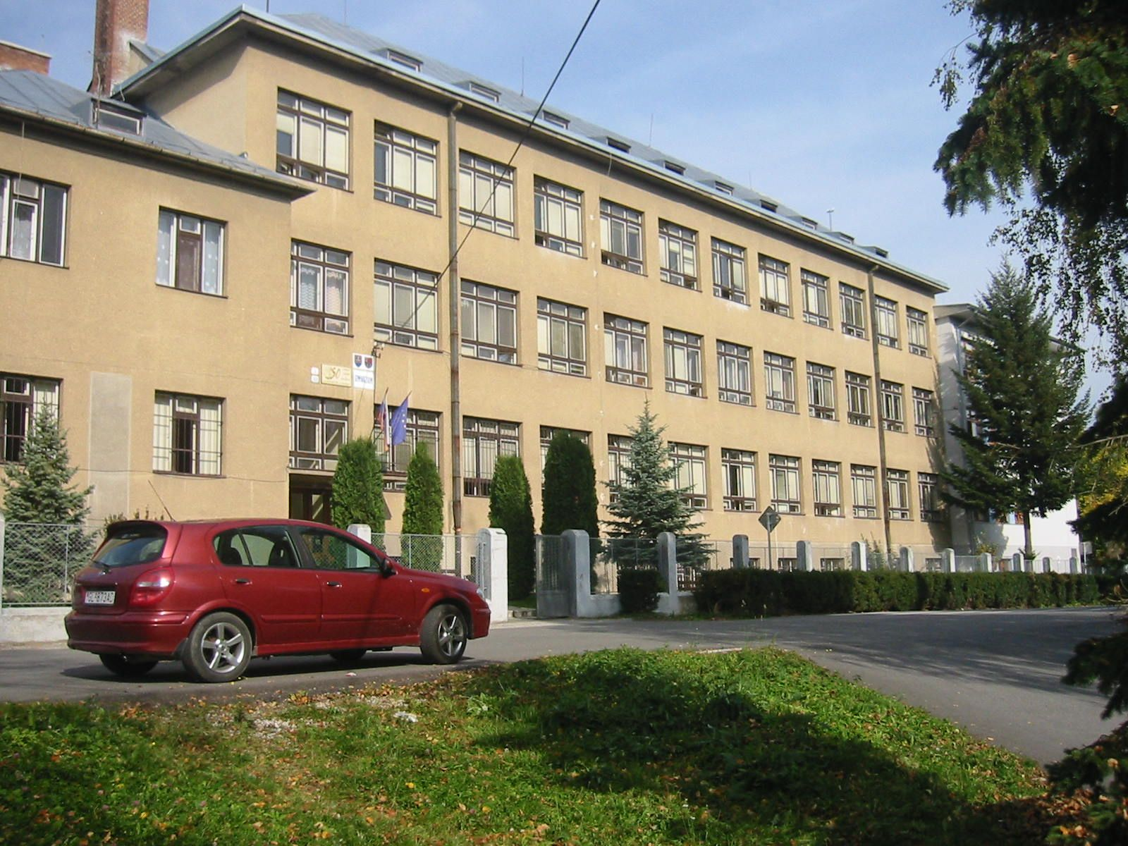
GRAMMAR SCHOOL in Gelnica

Slide 2
Special school preparing for university studies
4oo students, 30 teachers
Students from 10-18 / eight- year grammar school/ specialisation: foreign languages
Students from 15-19/ four- year grammar school /specialisation: German or IT
subjects> M, P, CH, B, Geo, H, Art, P.E., R.E., civics, E, F, G, ethics, aesthetics,
No registration / meeting every month 45 min

Slide 3
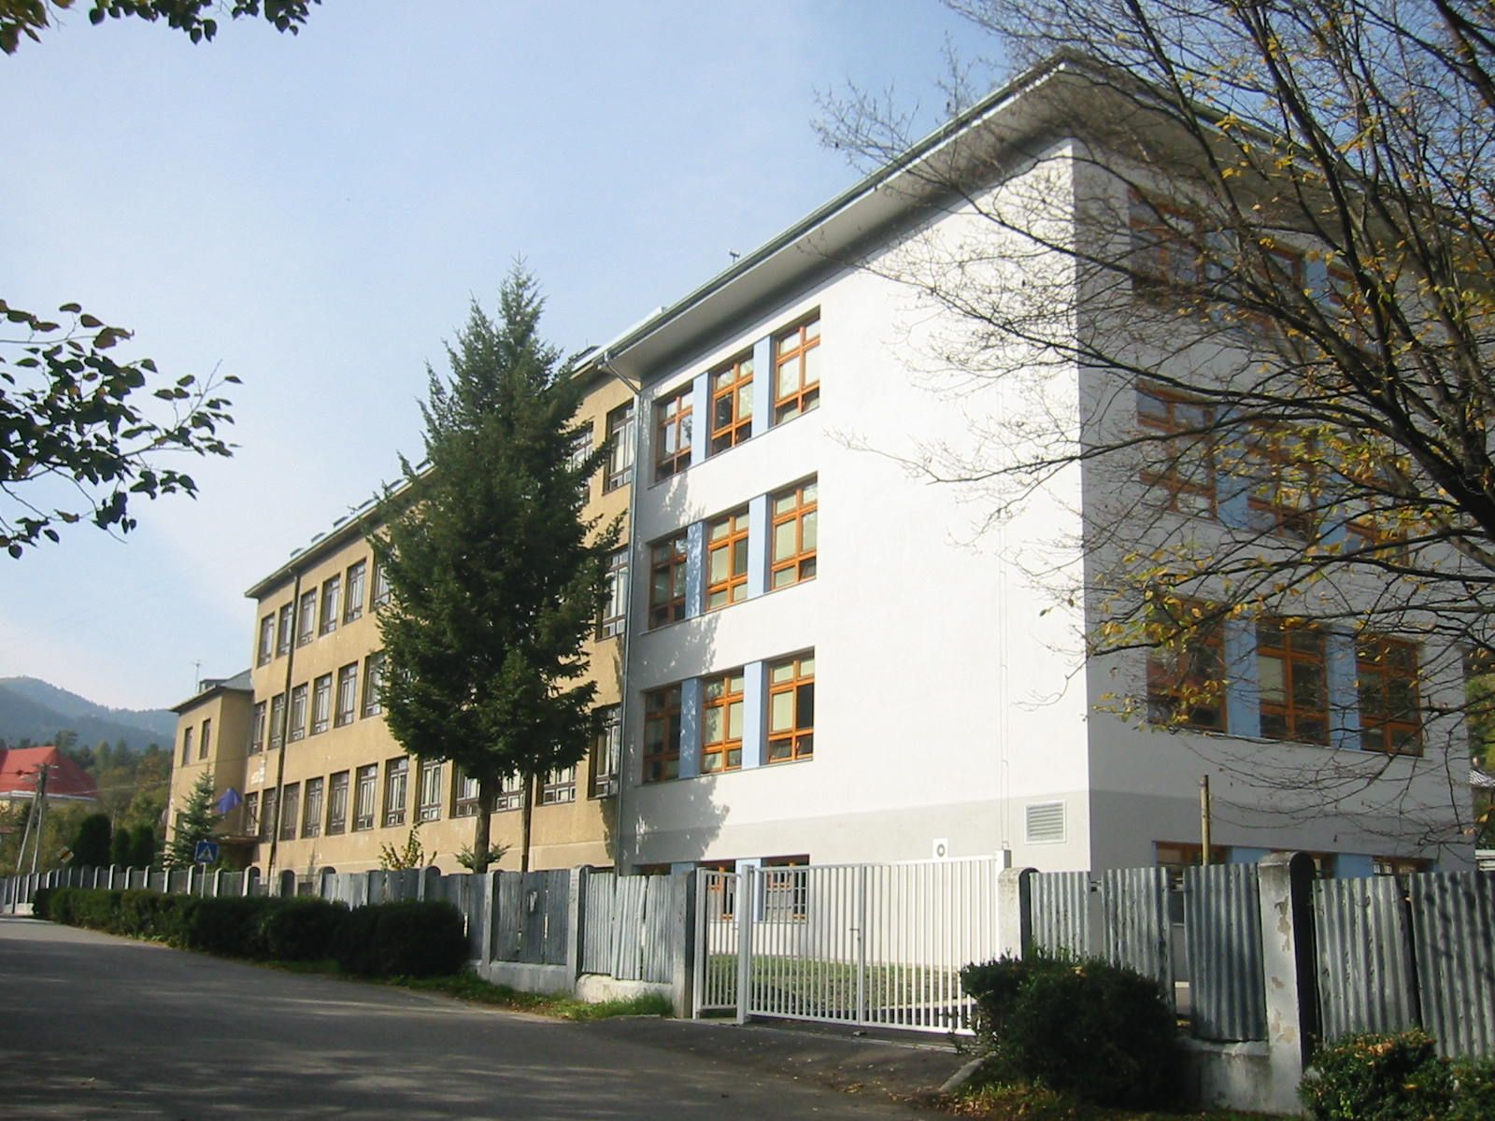

Slide 4
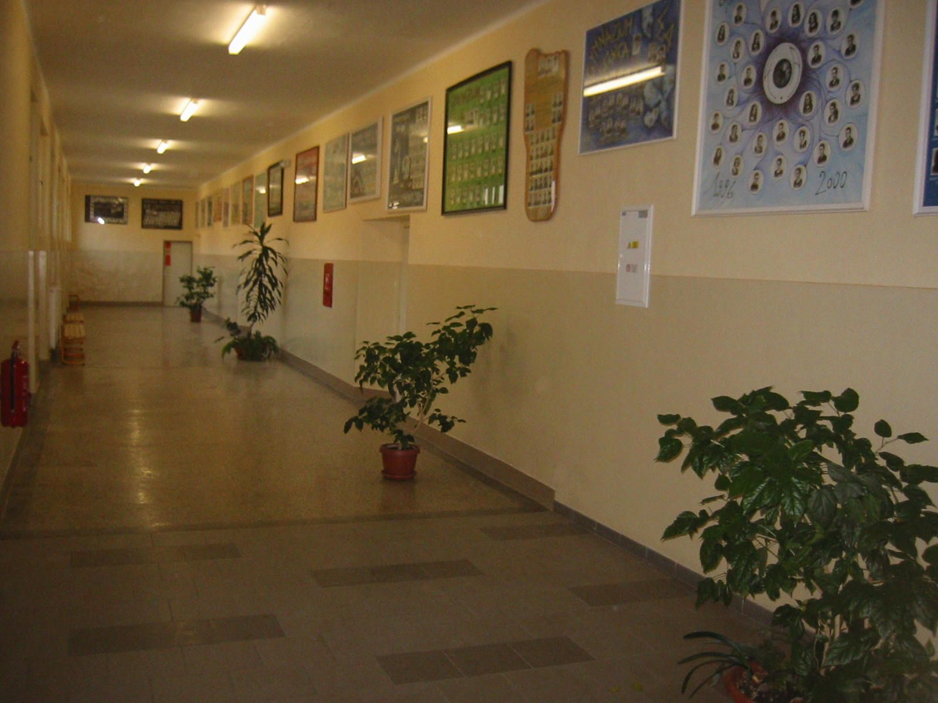
Students stay in their classrooms teachers move

Slide 5
Differences
Students do not wear uniforms
They are tested every day at each subject, homework every day
They have to learn much after school
Diaries have to be signed every day by parents
They bring all the books, exercise books rulers, pens, pencils in their bags every day
They are well behaved, polite, we do not have detentions or C1…

Slide 6
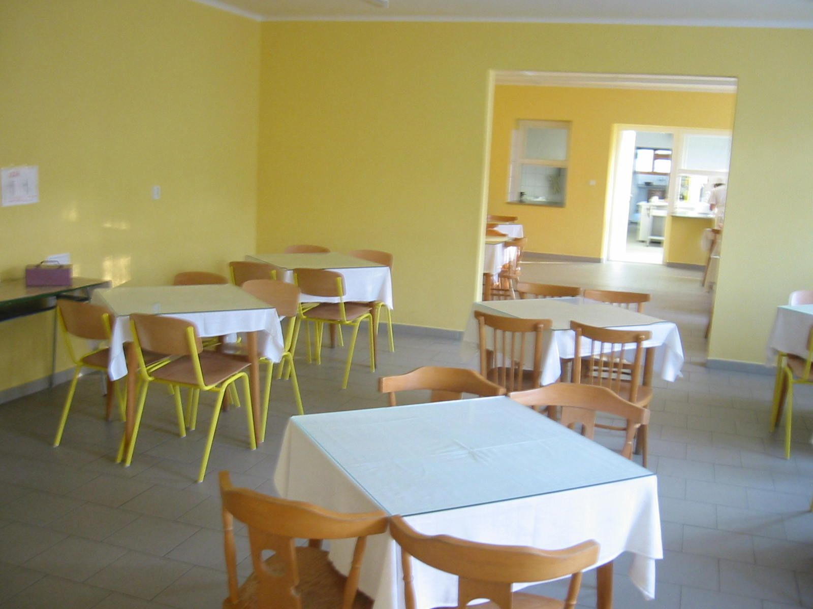
Lessons start at 8 a.m.
There are 30 lessons a week :4, 5, 6, 7 a day
One lesson lasts 45 minutes, breaks after each lesson 5 or 10 min., no lunch break/ we have lunch after classes
Lunch: soup and a main course, dessert, drink
We have got a vegetarian meal too

Slide 7
SCHOOL YEAR
2 terms
1st - 3 September/ 31 January
2nd - 1st February/ 30 June

Slide 8
Diary and reports
Diary
English/vocabulary test 4 molnarova
Maths/ drawing a cube 3 andrasko
Class book
Andrew Black
German: 2, 4, 5, 1, 3, 3 final mark: 3
Slovak: 1, 2, 3, 1, 1, 2 final mark: 2
Reports/ twice a year after the term ends 31 January and 30 June
All the subjects and final marks

Slide 9
HOLIDAYS
Autumn / 4 days
Christmas/ 2 weeks
Half year / 1 day
Spring / 1 week
Easter / 1 week
Bank holidays together 7 days
Summer 9 weeks

Slide 10
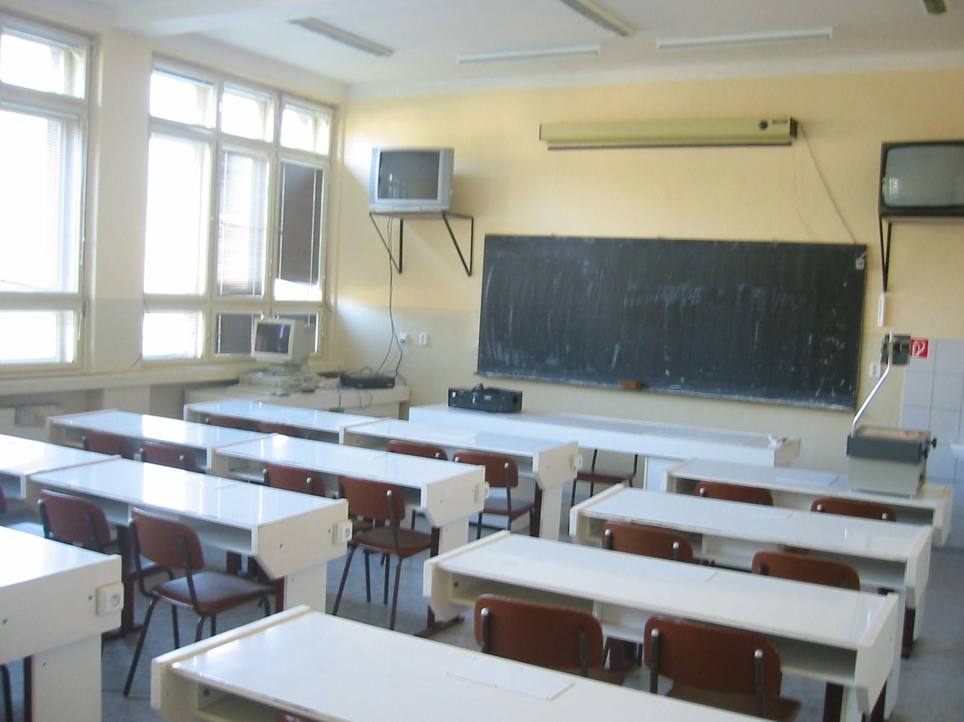

Slide 11
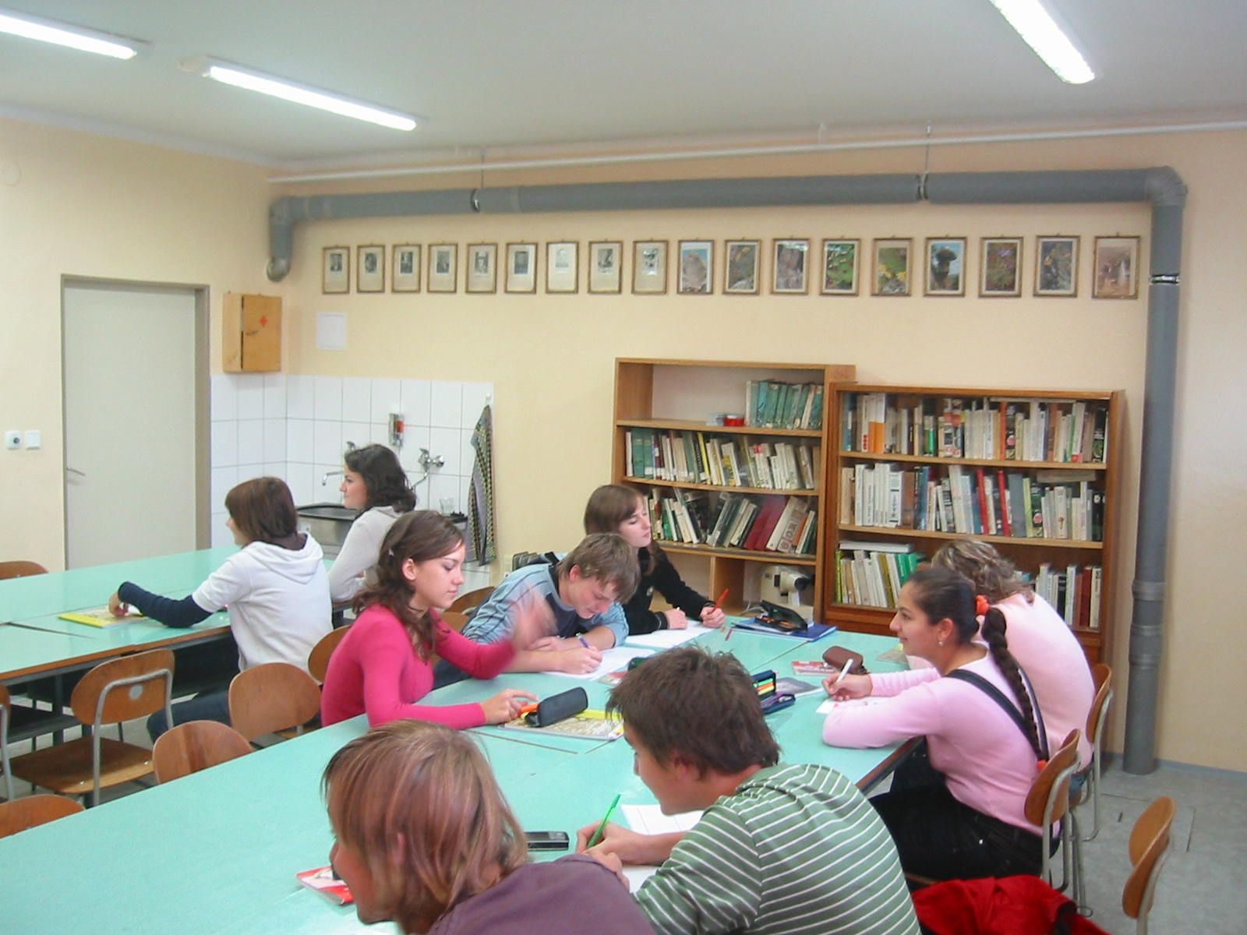

Slide 12
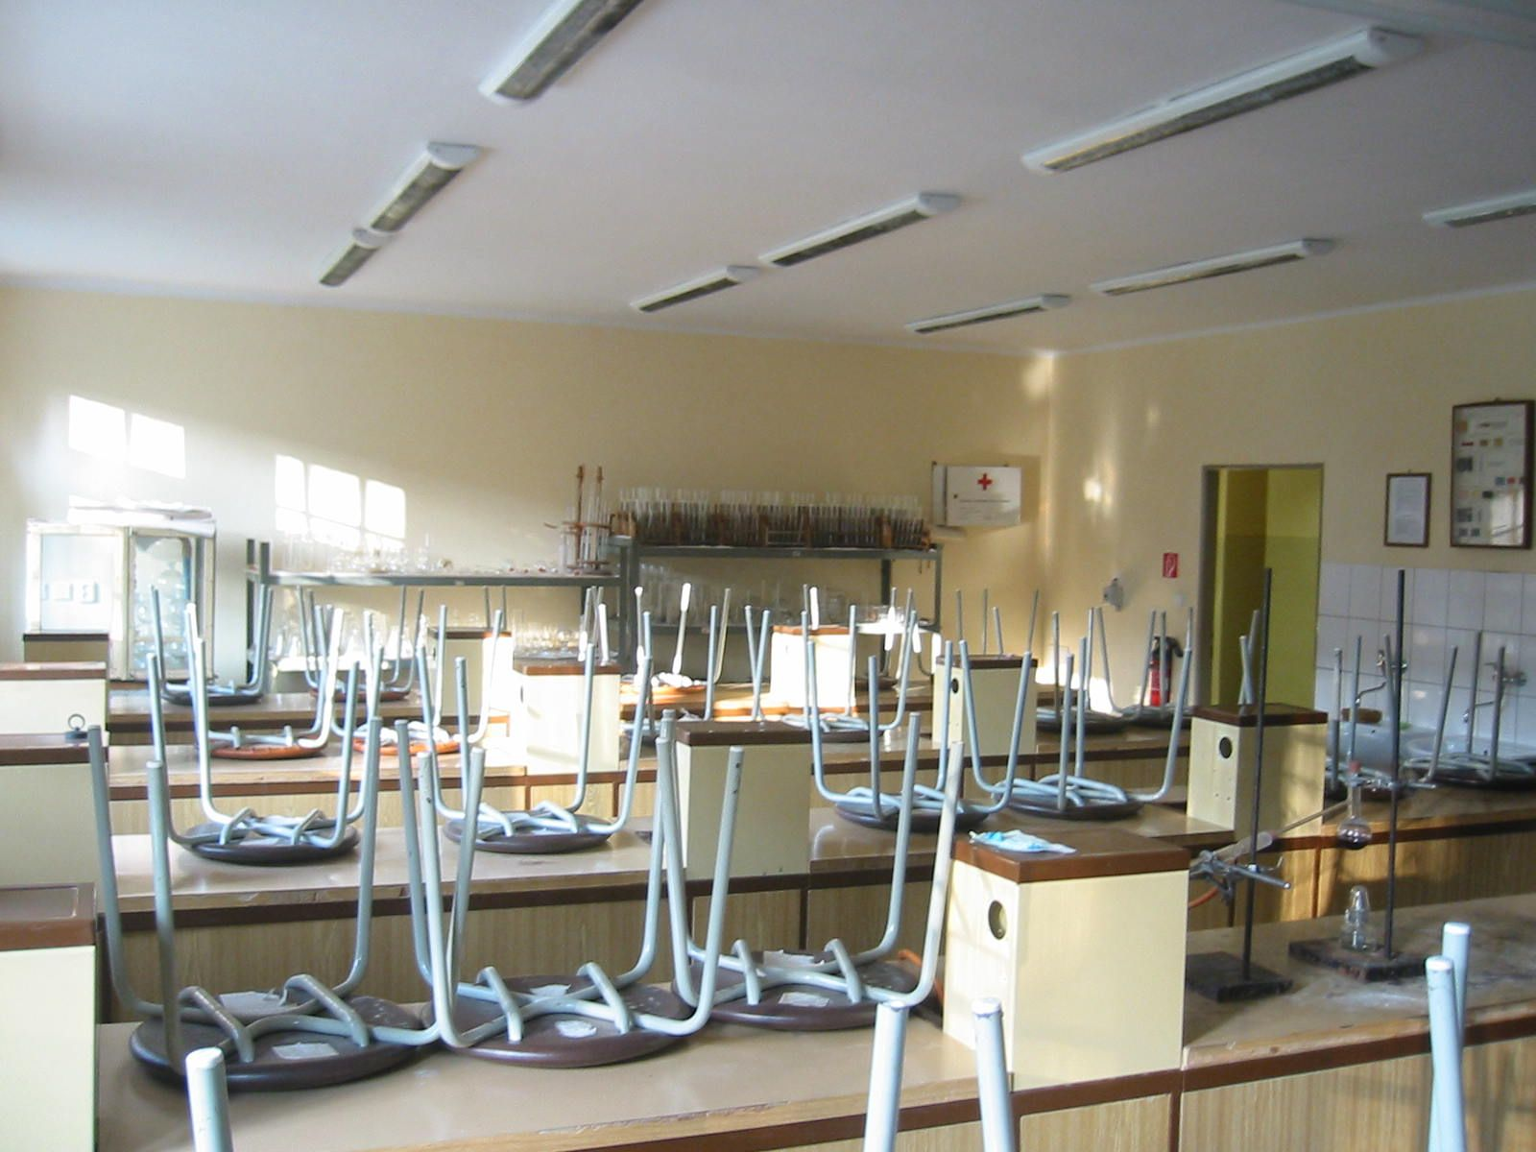

Slide 13
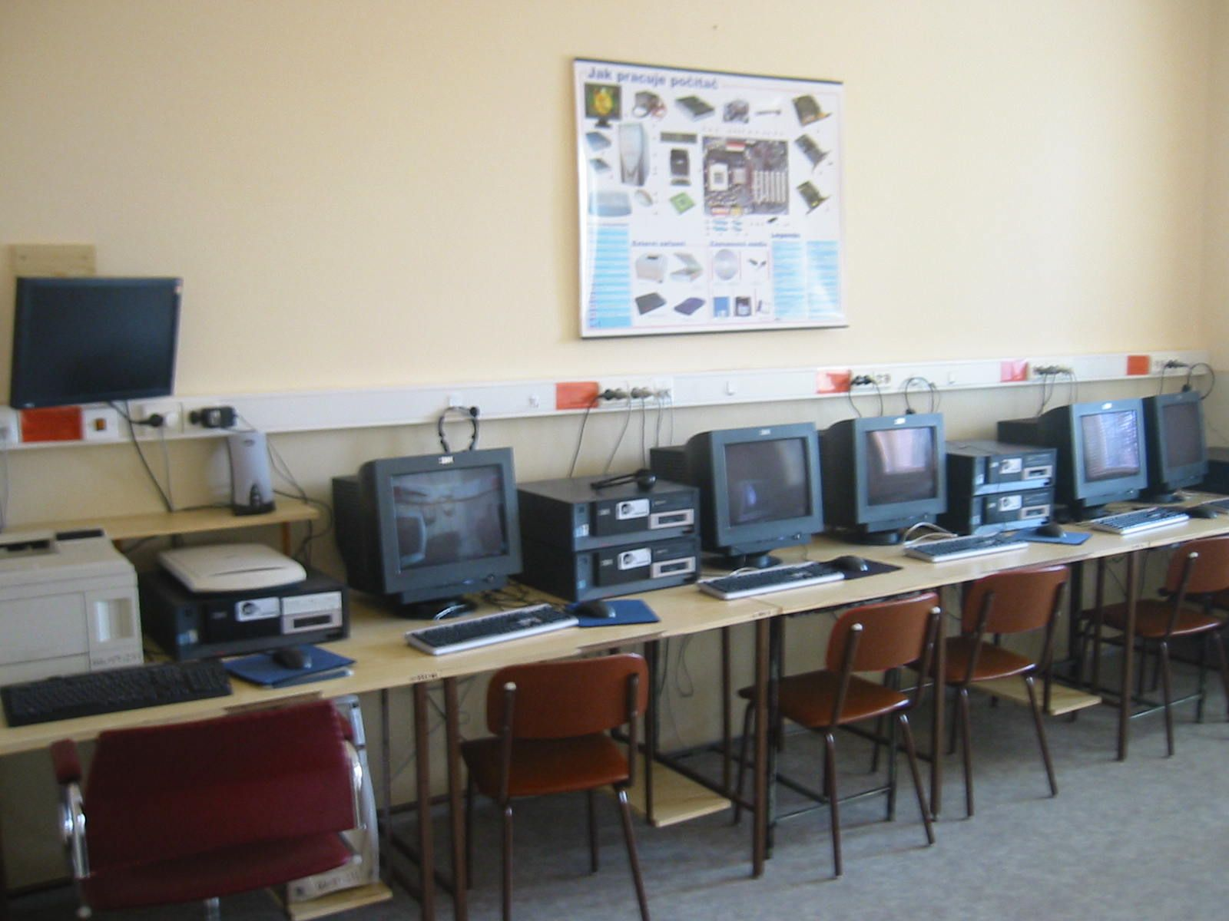
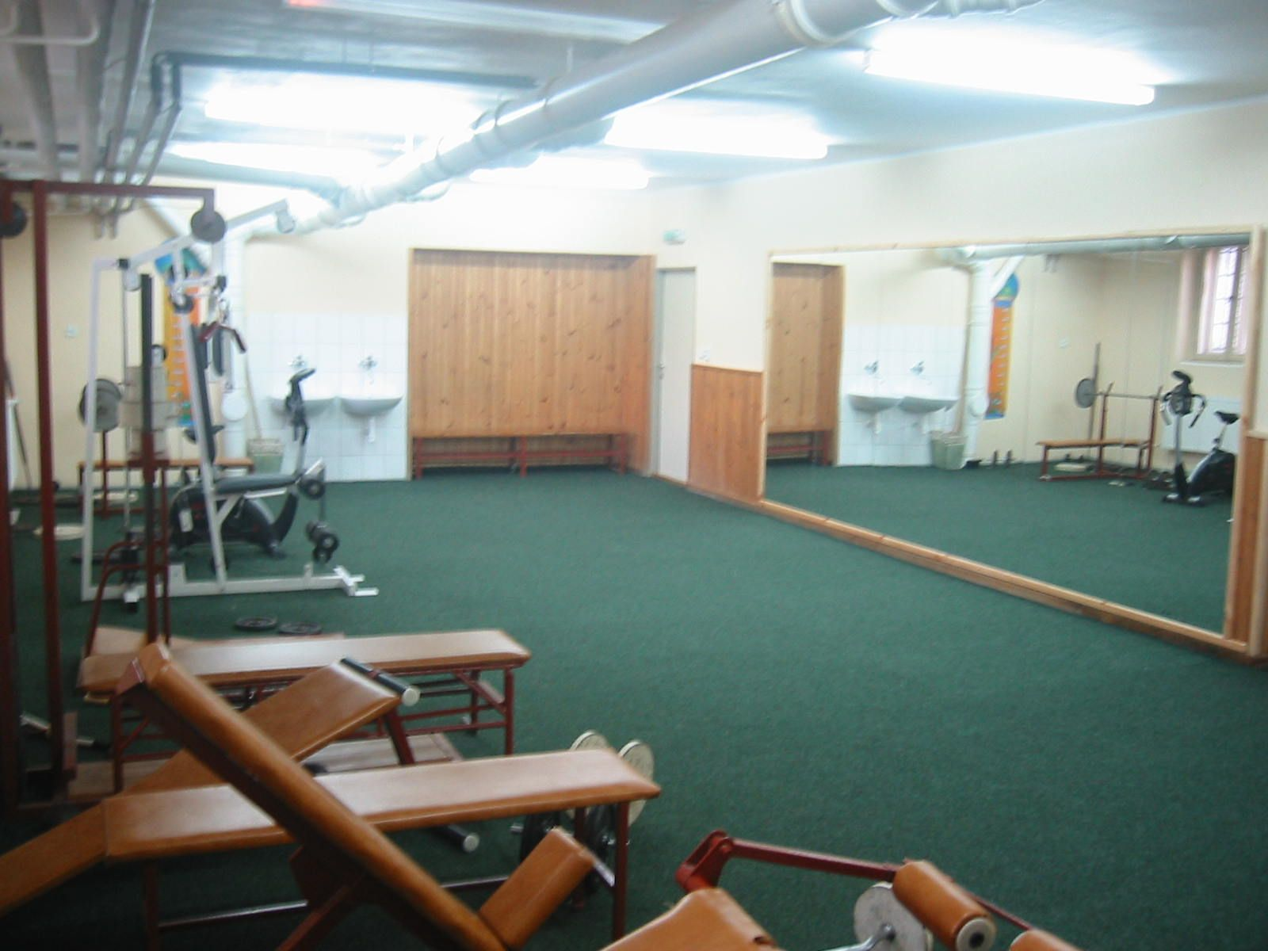

Slide 14
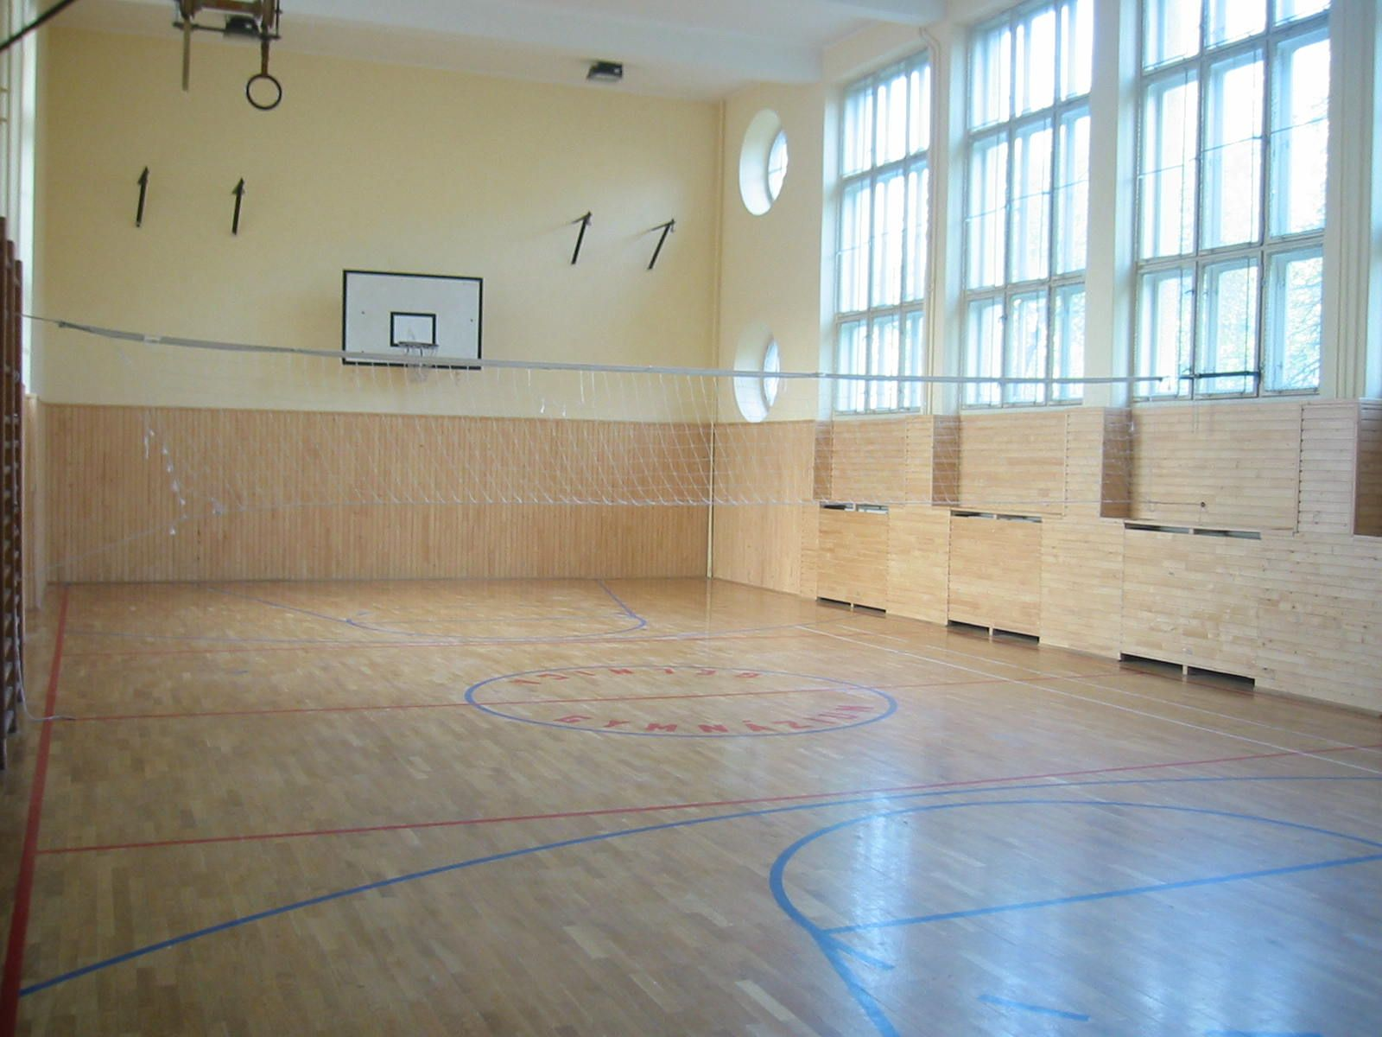

Slide 15
